Slide 1
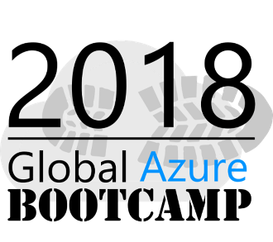
Azure Application Insights and Jupyter Notebook to analyze large scale data
Notes:
Hope you all enjoyed awesome lunch and having an awesome day .
Apparently thanks and welcome
Not just any monitoring, but proactive monitoring!
This session will help you and your team identify issues before your users have a chance to tweet, email or Instagram that issue that affects their smooth user experience
Visual Studio (Code) tooling,
intelligent monitoring,
advance analytics,
dependency maps and devops integration are some of the awesome features that AppInsights have to offer .
Developers are delighted, Operations teams are happy and managers can finally focus on creating awesome teams and products instead of firefighting issue after issue.
Don't believe me? Great! Join me in this session and let me prove you wrong!

Slide 2
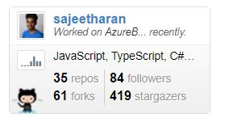

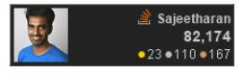
Who am I?
Senior Tech Lead at 99X Technology
MVP – VS and Development technologies
Top Contributor on Stack Overflow https://stackoverflow.com/users/1749403/sajeetharan
Opensource Contributor
https://github.com/sajeetharan
Angular Enthusiast
https://stackblitz.com/@sajeetharan

Slide 3
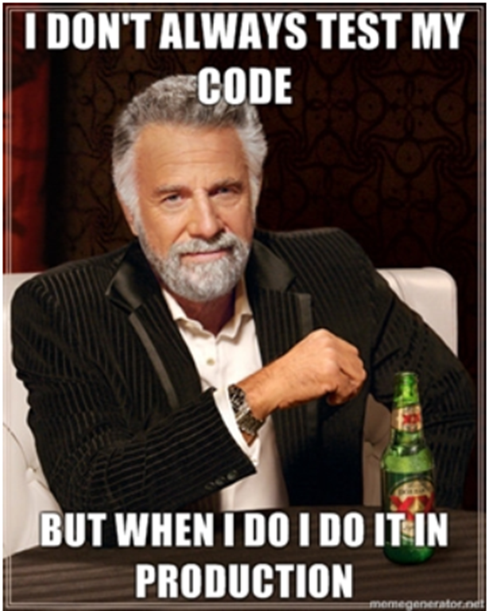

Here is a small story….
Notes:
The application crashed every time I am drinking coke Time out procedure
One who manage 24/7 operations Question?two components, Every application different
today we have very different components
Not hello world ,a lot of things flying around all over the place one of the
obvious thing to manage is to log all the things.
when site is down everyone is stressed
logs to a file somewhere on the file and distributed to customers who never looked or understand

Slide 4
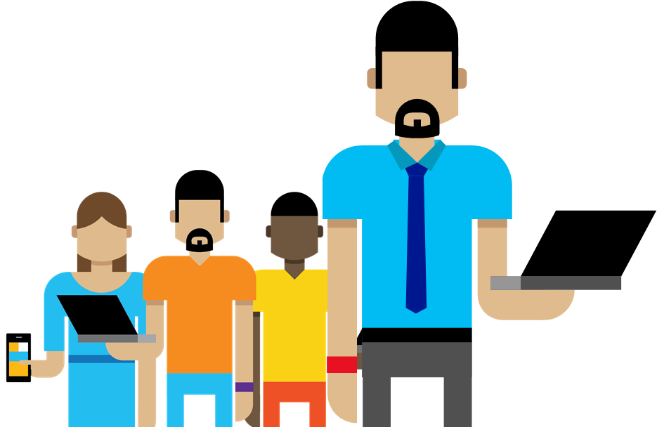
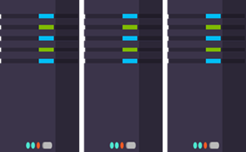
Why Logging?
1
Troubleshooting
Did a problem occur? Where? When?
2
Performance/Cost
Is the Application slow? How many requests?
3
Analyze Trends
Need more storage? Need more servers?
4
Customer Experience
Is your system making everyone happy?
5
Business Decisions
Increase in sales?
Notes:
Most log files really suck. typically why would you log stuffs in application
troubleshooting- did a problem occur? where? our code? machine
performance/cost = did we make application slower - how many requests are coming, may be need of addition machines
improvement- can a problem be detected or avoided - exception is occurring, what is the causing
trends - need more storage? need more servers? - disk runs out of space, how can i fix this
customer experience - are people happy? or seeing error after error? 5 seconds to load application
business decisions - can we increase sales based on log data/telemetry - page views number of orders go to your transacation.

Slide 5

What is Application Insights?
“Application Insights is an extensible Application Performance
Management (APM) service for web developers on multiple
Platforms”.
1
3
Telemetry is collected at each tier: Mobile applications, server applications and browser
Get a 360° view of the application including availability, performance and usage patterns
2
Telemetry arrives in the Application Insights service in the cloud, where it is processed & stored
Notes:
i see 80 pages document on a regular basis
security audits, review and early detection
Telemetry collected at each level
Process and stored at once
360 view availability performance and uage patterns

Slide 6
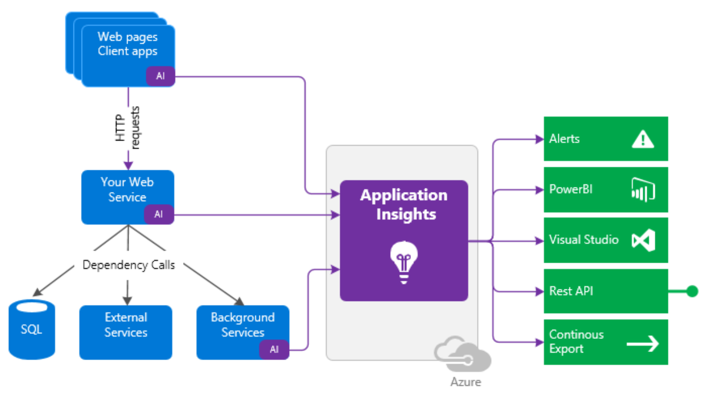
How it works
Notes:
Implement a interface typed implementation
Single line logger
something super simple.
you all look serious but this is something fun to implement.
Using serilog, serilog sync

Slide 7
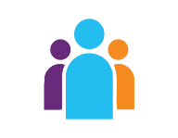



Sources of Telemetry
1
Outside-in monitoring
URL pings and web tests from 16 global points of presence
2
Observed user behavior
How is the application being used?
3
Developer traces and events
app
Whatever the developer would like to send to Application Insights
4
Observed application behavior
platform
No coding required – service dependencies, queries, response time, exceptions, logs, etc.
infrastructure
Infrastructure performance
5
System performance counters
Notes:
tracking change history
wat sort of changes have been done in the system.
what to log
event
audit logs -
activity logs
history logs
things going in the system.

Slide 8









Key capabilities
Any app support
Easily add analytics across multiple platforms including: ASP.NET, Java/J2EE, iOS, Android, Windows, as well as OSS technologies such as Node.JS, PHP, Ruby, Python, etc.
Open source SDK: https://github.com/Microsoft/ApplicationInsights-Home
Logging framework: Log4Net, nLog, System.Diagnostics Log4J, Logback
Notes:
out of the box, also enriches your data

Slide 9
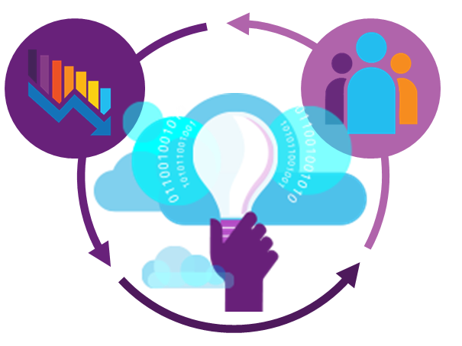
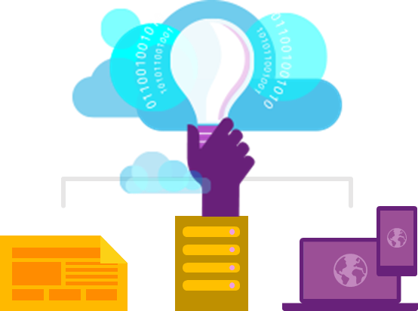
Key capabilities
360° View Across
Availability, Performance & Usage
Overall app health via Overview Blade
Quickly correlate performance & usage data
Detailed insights with a click of a button through intuitive data exploration
Fast & Powerful Diagnostics & Usage Insights
Quickly diagnose availability & performance issues
Learn & improve continuously with usage insights
Extend your telemetry data
Export your data for further analysis
Built-in Analytics
for any app
Supports any app type
Zero-click enablement
No-touch monitoring
Notes:
if you want to correlate specific trace message with your cpu machine, the information is already on appinsights, you have to just query it
Allows you not only to ship login information but also custom events, so that
we can correlate event with business information( combine information for analysis)
90 days , continous export

Slide 10
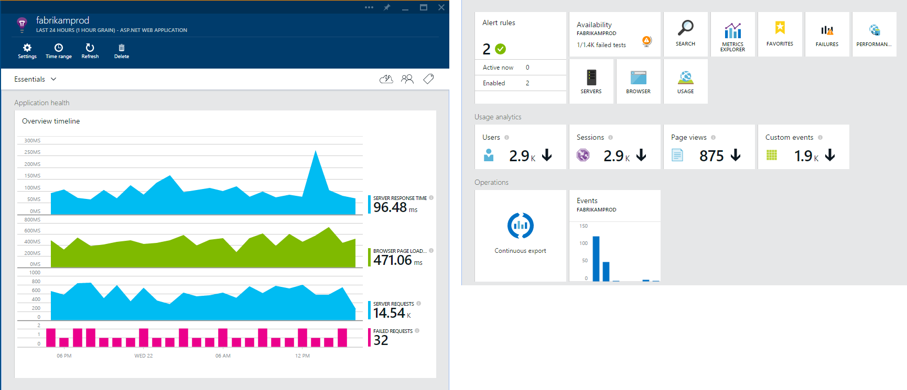
Overview Blade
Out-of-the-box experience
Provides a summary of the application’s health - availability, performance and usage
Paired timeline allows users to quickly correlate metrics and identify trends

Slide 11
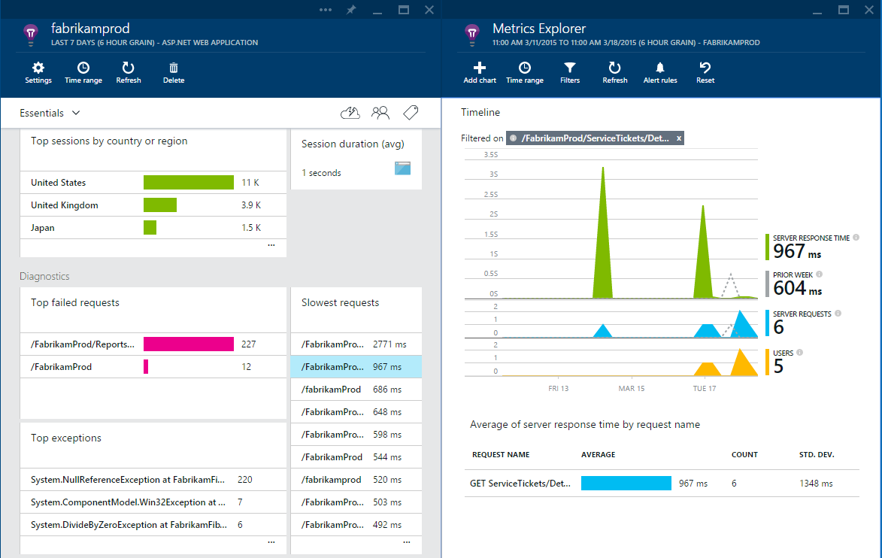
Drill down
Detailed insights with the click of a button
Correlate performance and usage in a single view
Pinpoint problems and investigate questions like “Do I have network performance issues that hurt user adoption?”
Click on specific metrics, and drill into detailed information and answer questions such as “what request is failing the most?”

Slide 12
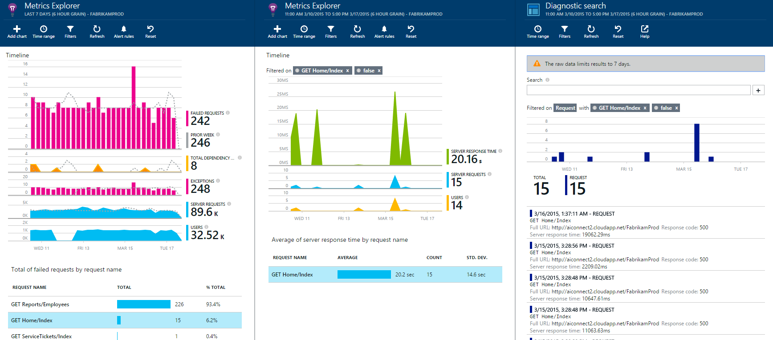
Drill down tools
Powerful insights with Metrics Explorer and Diagnostic Search
Metrics Explorer provides a flexible multi-dimensional UI over custom and out-of-the-box telemetry collected
Diagnostic Search enables efficient search over large sets of data using the query experience
Notes:
capturing dependencies is a cool feature. try sql server
there are lot of information user click and sql error
requests both on client side and server(correlate both client and server)
traces using serilog (structured logging , performance counter with specific customer)
logging depenedencies with custom details different view
failed request- drill down to spefici exception and which line of code. which is really useful
usage - who is using my application from different locations session by country ( this is not like google analytc)
performance - which page is fast in terms of load
servers-
browsers - how long does it take to render my SPA etc
really production application( load test on applicaiton)
Analytics - Soft of addon or separate based on internal tool used at microsoft, pretty much same as sql queries on top
of your logging information, also you can run queries on top of that.
queries over logs
based on datasets
there are number of dimensions that you send to app inshgts, can be used as inputs for queries
where clauses , project , join with datasets
render those as table or as charts which would give some graphical information.
should not take too long
this is the view that you have in application analytics. predfined queries that comes
thats powerful given that i am running query on data
visual studio plugin

Slide 13
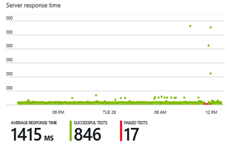
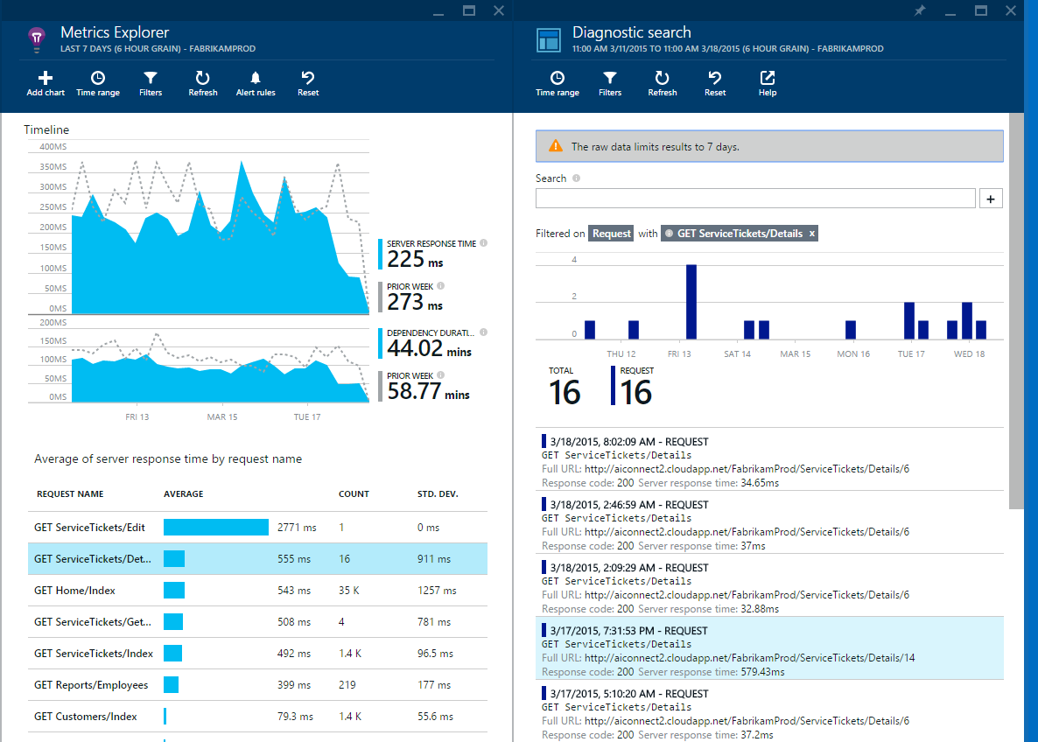
Fast and powerful insights
Identify & triage availability issues
Diagnose & solve performance problems
Mobile crash/sever exception analytics
Notes:
Monitor your web sites with simple pings to complex web tests from points around the world
Quickly diagnose issues by accessing rich application performance data from the client view to dependencies
Real time view of crashes happening on devices, allowing you to focus on fixing key issues with the biggest impact first

Slide 14
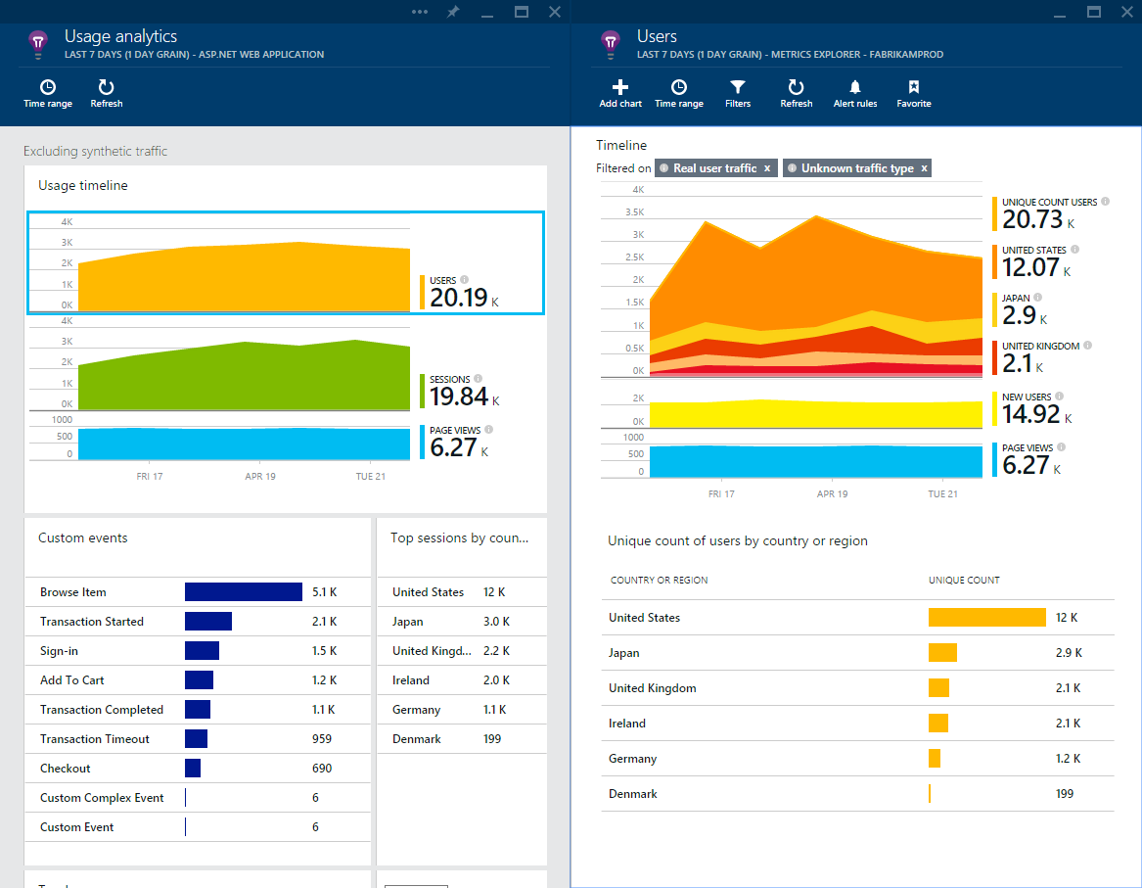
Fast and powerful insights
Learn & improve with usage insights
Notes:
Understand where your users are coming from and where they spend most of their time
Prioritize future investments and continuously improve your app based on user activity and usage patterns and trends

Slide 15
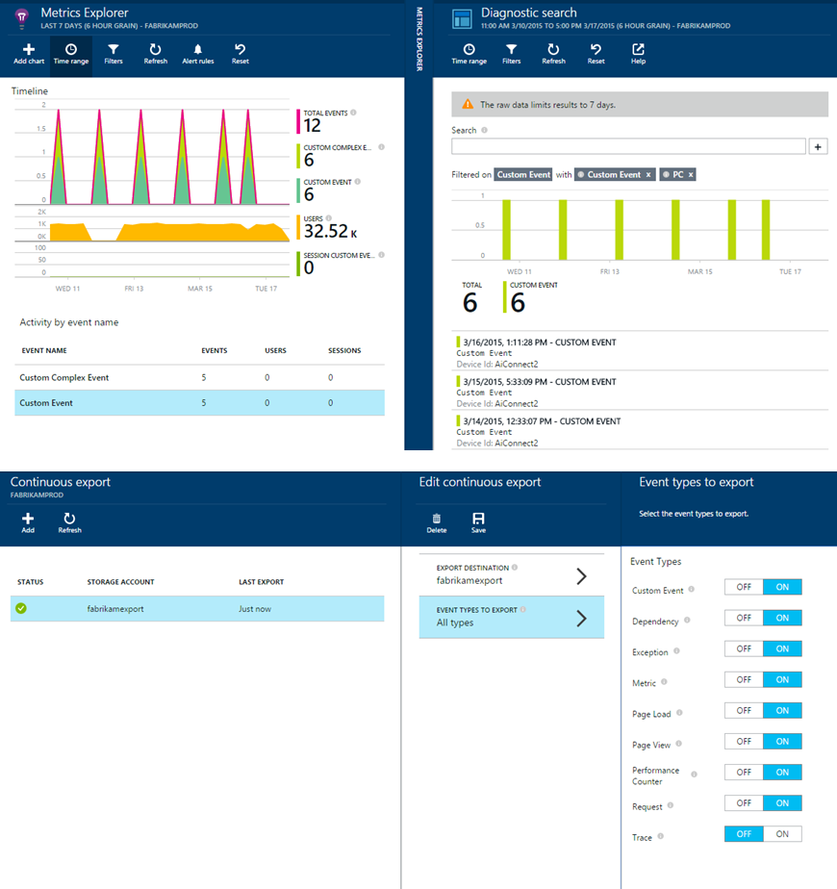
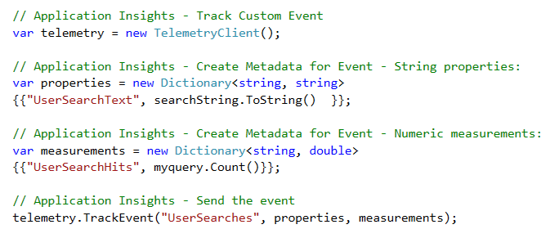
Fast and powerful insights
Extend telemetry data
Add custom metrics and events to better track and analyze user activity
Continuously export data to Azure Blob Storage for custom integration with other data sources and further analysis
Notes:
if you are running a vm and want to log vm information you need to add those agents to log information.
custom events. you have to add telemetery client which you can use to track custom evnets
couple of things to do , its not rocket science its very easy to get started.

Slide 16
What is Jupyter Notebook?
“An opensource web application to create and share documents that contain live code, equations, visualizations and explanatory text."
1
Language of choice
Edit and run notebooks via a web browser
2
Big data integration
The kernels and a dashboard
Notes:
As a server-client application, the Jupyter Notebook App allows you to edit and run your notebooks
Access without the internet
Its two main components are the kernels and a dashboard.
A kernel is a program that runs and introspects the user’s code.
The Jupyter Notebook App has a kernel for Python code,
The dashboard of the application not only shows you the notebook documents that you have made and can reopen but can also be used to manage the kernels: you can which ones are running and shut them down if necessary.

Slide 17

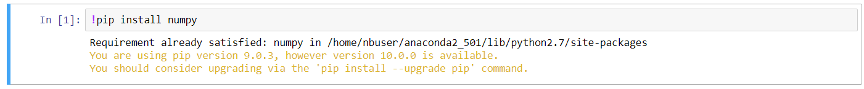
Here comes Azure Notebook
3
Great for sharing and collaborative work
1
Great memo pad - Write Code like a sticky note
2
Execute in units of cells
Notes:
Supports all imports and exports
Great for sharing and collaborative work
Supports variety of data types within the same window such as text, code, graphs, videos, pictures
Great for Visualizations
Enables parallel computing

Slide 18
Let’s code
Add Azure Application Insights to your ASP.NET Core web application
Dive into Azure Notebook with data analysis
AppInsights with Azure Notebook saves the day
Notes:
sounds interesting and want to experiment

Slide 19
Who wants some stickers?
Q & A

Slide 20
Where to go from here….
Access the demo and slides
https://github.com/sajeetharan/AzureBootCampAppInsights
Rate my session
https://www.rateevent.com/speeches/SCAAA663
Tweet me @kokkisajee
Notes:
Conclusion
structured logging enrich technical logs with business data
thank you for being here enjoy the rest of the day.

Slide 21


Silver Sponsorship

Slide 22




BRONZE Sponsorship

Slide 23




GENERAL Sponsorship

Slide 24


PRINTED MEDIA PARTNER
ORGANIZING SUPPORT PARTNER

Slide 25


OTHER SPONSORSHIPS

Slide 26







global SPONSORSHIPS

Slide 27


All attendees get the following:
Sponsor | Offering
Cloudmonix https://cloudmonix.com | Cloudmonix offers a $300 off any paid plan for Azure monitoring! http://bit.ly/gab2018-cloudmonix Code: GAB2018
MyGet https://myget.org | MyGet offers a free 1 month Starter Plan for hosting your NuGet, npm, Maven, Bower of VSIX feeds! http://bit.ly/gab2018-myget Code: GGAB2018-MG
ServiceBus360 https://servicebus360.com | Servicebus360 is offering 2 months free of their Gold Plan! http://bit.ly/gab2018-sb360
Cerebrata https://cerebrata.com | Cerebrata is providing a 3 month subscription to it’s Cerulean product! Get your subscription key from your organizer!
Offers valid until April 30th

